Slide 1


Portfolio Website Development Internship Project at Micro IT India
Internship Mentor
Aryan Choudhary
Shaik Farzana
B.Tech(AI&DS)

Slide 2
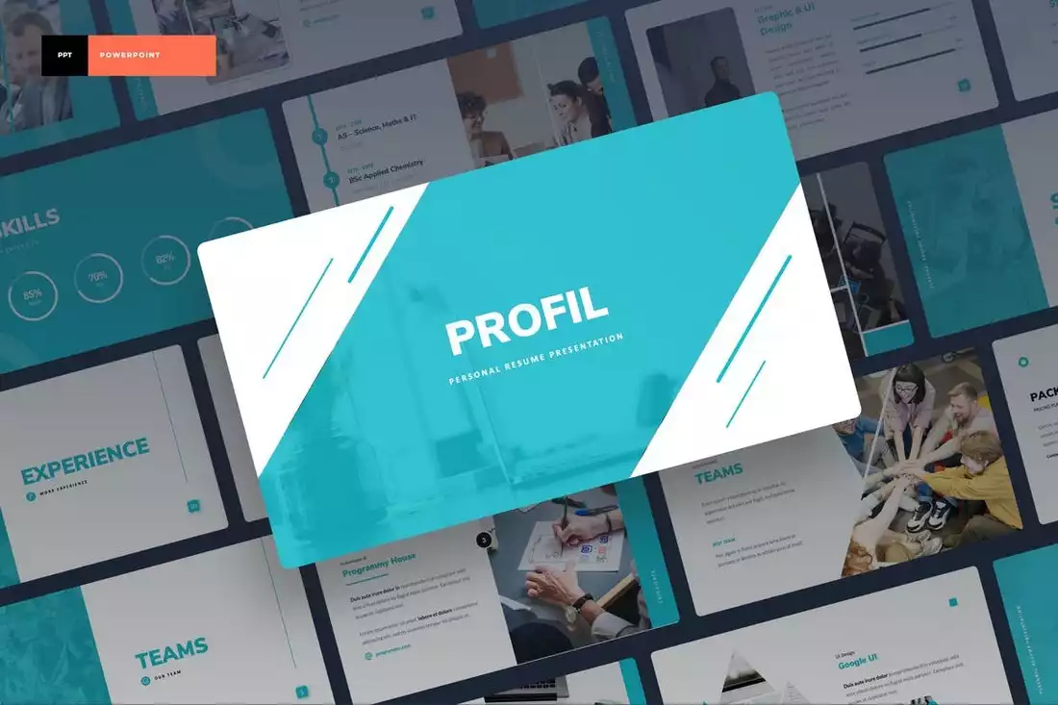
Contents
Introduction
Technologies Used
Project Steps
Screenshots
Conclusion

Slide 3

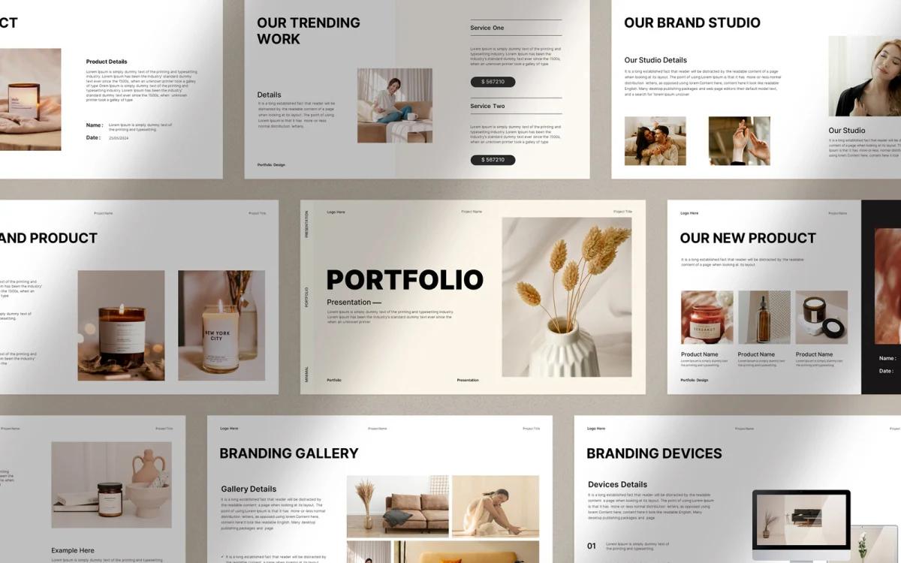
Introduction
Importance of a personal portfolio website
Purpose of the project
Technologies used: HTML, CSS
Learning outcomes: responsive design, personal branding

Slide 4
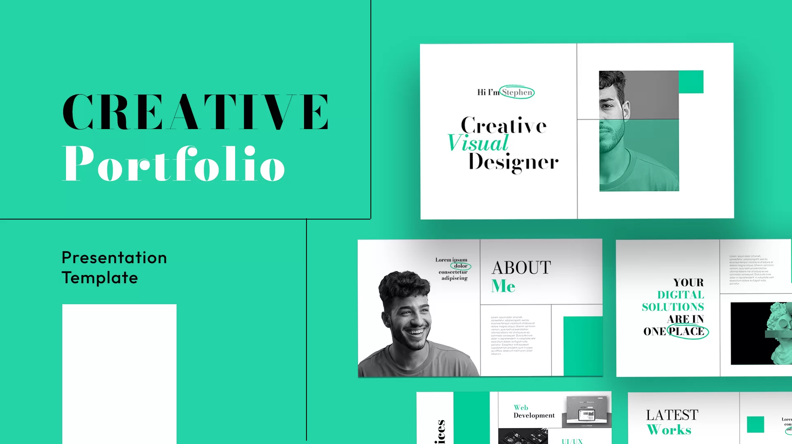
Technologies Used
HTML: Structure and semantic tags for SEO-friendly design
CSS: Styling, layout (Flexbox), responsive elements, buttons, hover effects
Portfolio Website Development

Slide 5
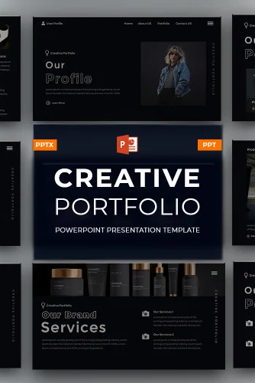
Project Steps – Part 1
Step 1: Setup Project Folder
Created folder and main files (index.html, style.css)
Step 2: Created index.html
Basic HTML structure
Sections: Home, About Me, Skills, Achievements, Projects, Contac

Slide 6
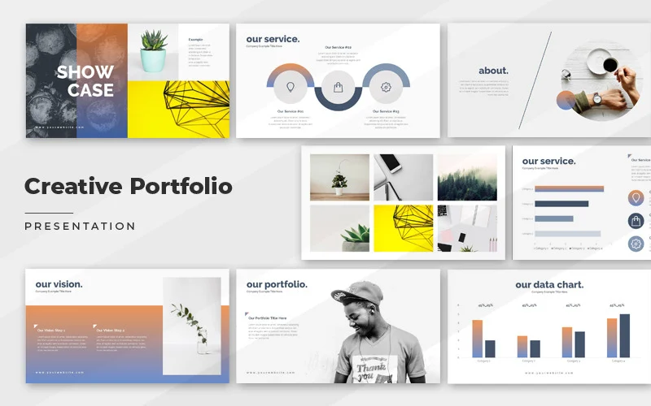
Project Steps (Part 2)
Step 3: Add Basic Styles (CSS)
Fonts, colors, layout
Contact section styling
Step 4: Add LinkedIn and GitHub Links
Clickable buttons with hover effects

Slide 7
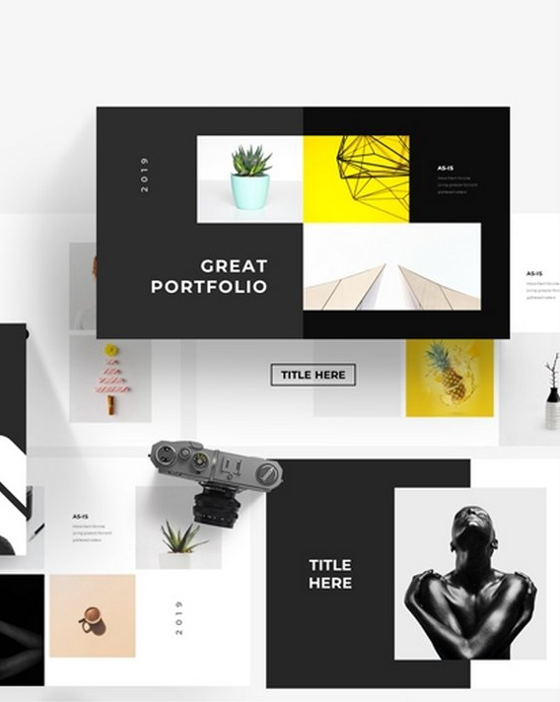
Project Steps - Part 3
Step 5: Testing the Website
Checked layout, design, links functionality
Browser compatibility

Slide 8
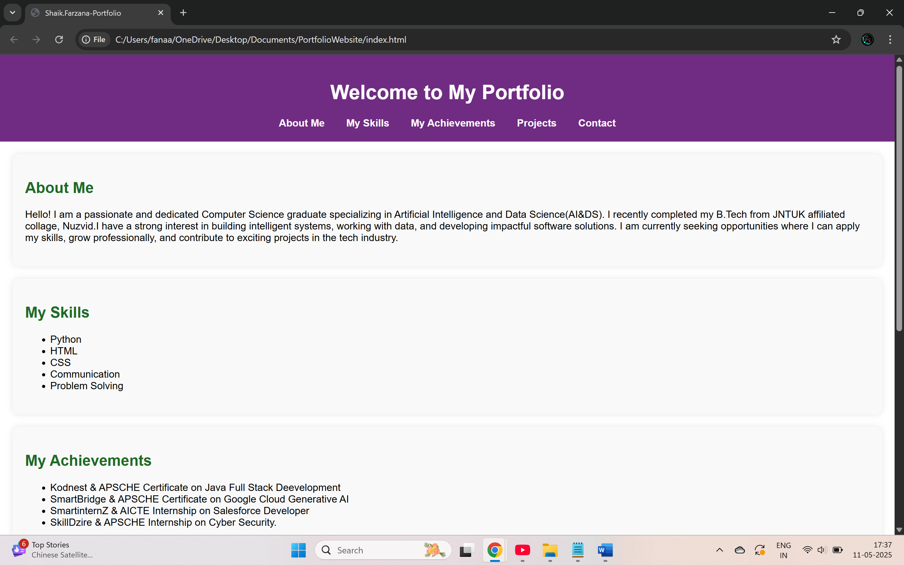
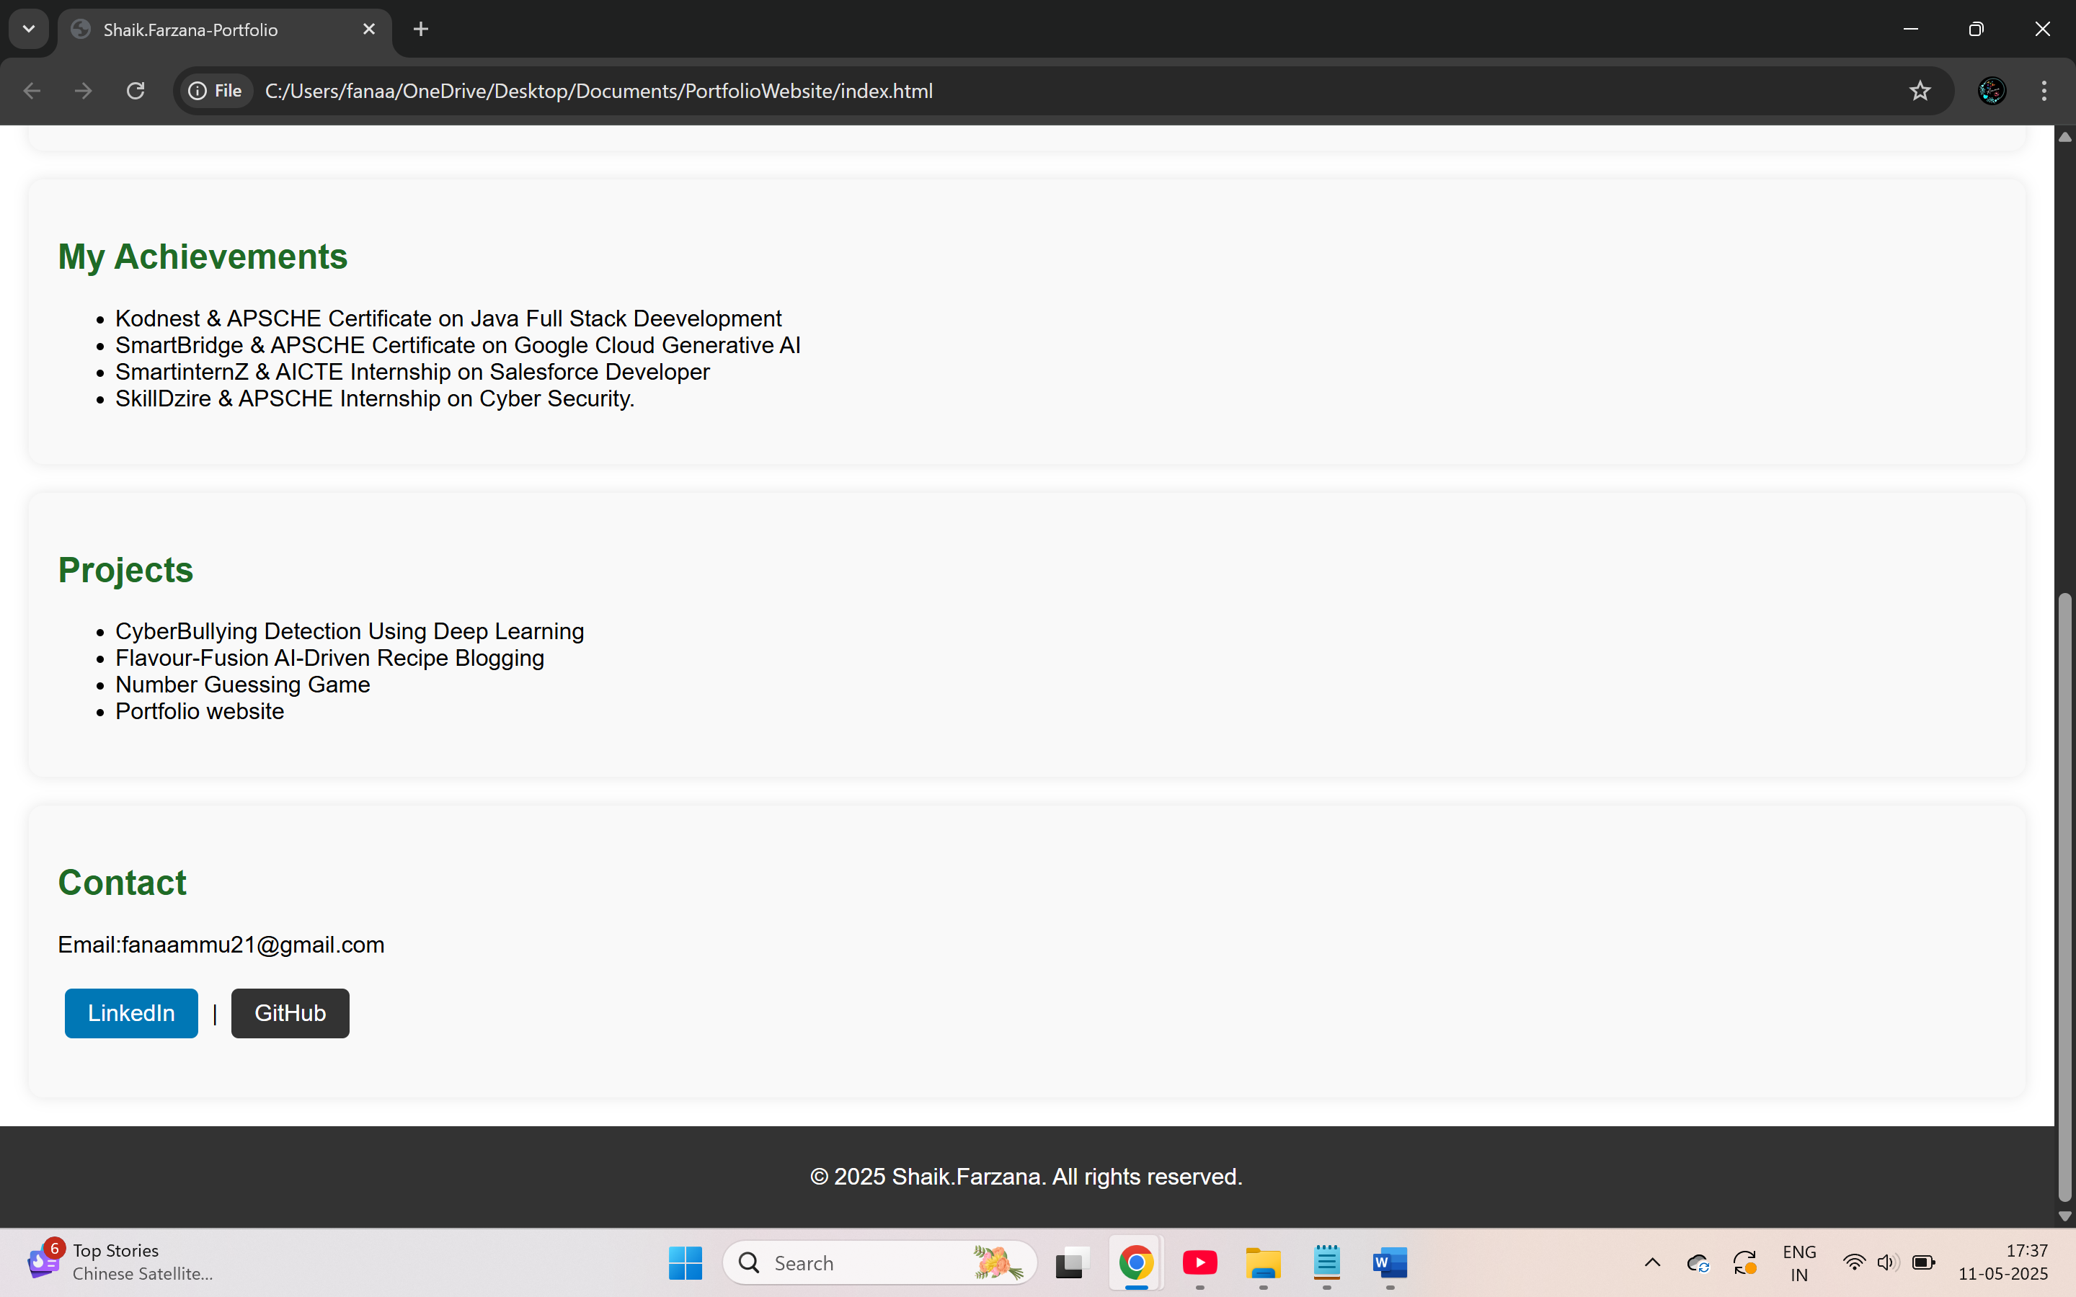
Screenshots

Slide 9
conclusion
Learned HTML structure and CSS styling
Importance of organization and debugging
Improved creativity and technical skills
User-friendly design and navigation importance
Boosted confidence in front-end development

Slide 10
Thank you
Shaik Farzana
fanaammu21@gmail.com

